Slide 1

German University in Cairo Faculty of Engineering and Materials Science Mechatronics Engineering Department
$$Ball Tracking Robot$$
Team 5 Members:
Waleed Atef
Abdallah Mohamed
Omar Magdy
Mohamed Shall
Fouad El-Sheikh
Notes:
"Good [morning/afternoon], everyone. Thank you for being here today. My name is Waleed Atef, and I am excited to present my bachelor project on the 'Influence of Car Trails on the Drag Force Acting on Other Cars'."

Slide 2
Outline
Introduction
Hardware Implementation (Fouad ElSheikh)
Raspberry Pi & Camera Setup (Waleed Atef)
Image Processing (Abdullah Mohamed & Omar Magdy)
Control (Mohamed Shall)

Slide 3
Outline
Introduction
Hardware Implementation
Raspberry Pi & Camera Setup
Image Processing
Control

Slide 4

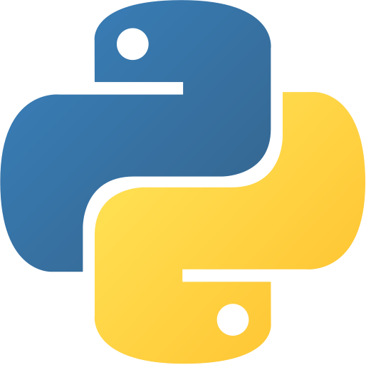
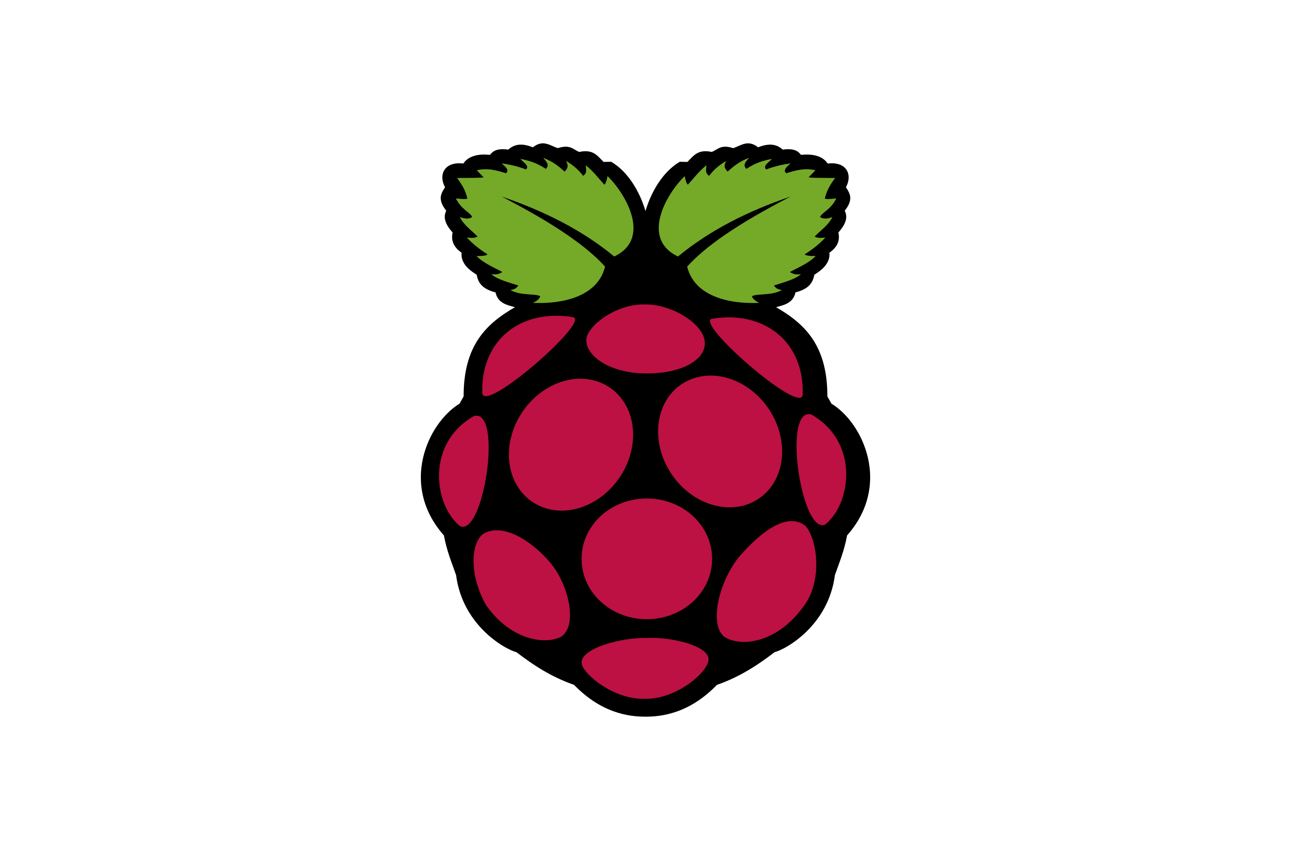
Introduction
Introduction
Hardware Implementation
Raspberry Pi &
Camera Setup
Image Processing
Control

Slide 5
Outline
Introduction
Hardware Implementation (Fouad ElSheikh)
Raspberry Pi & Camera Setup
Image Processing
Control

Slide 6
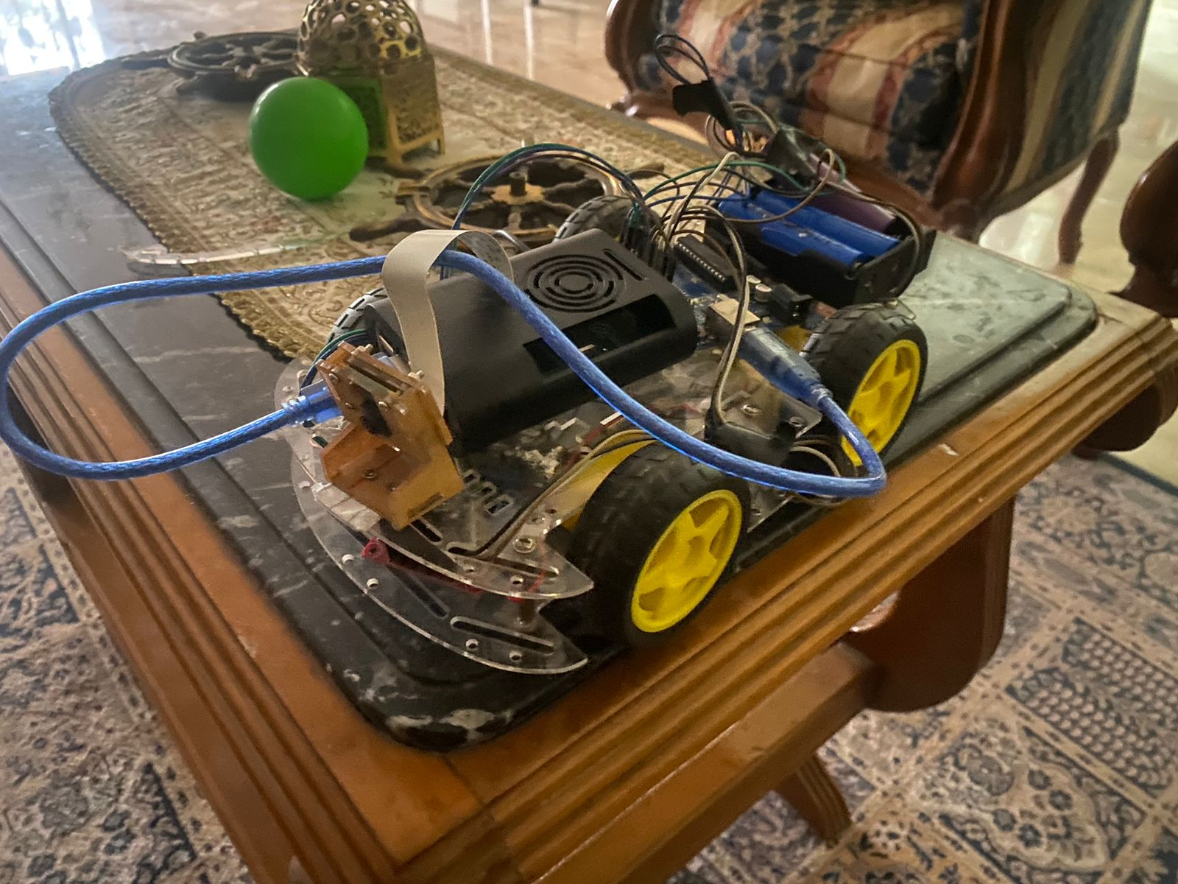
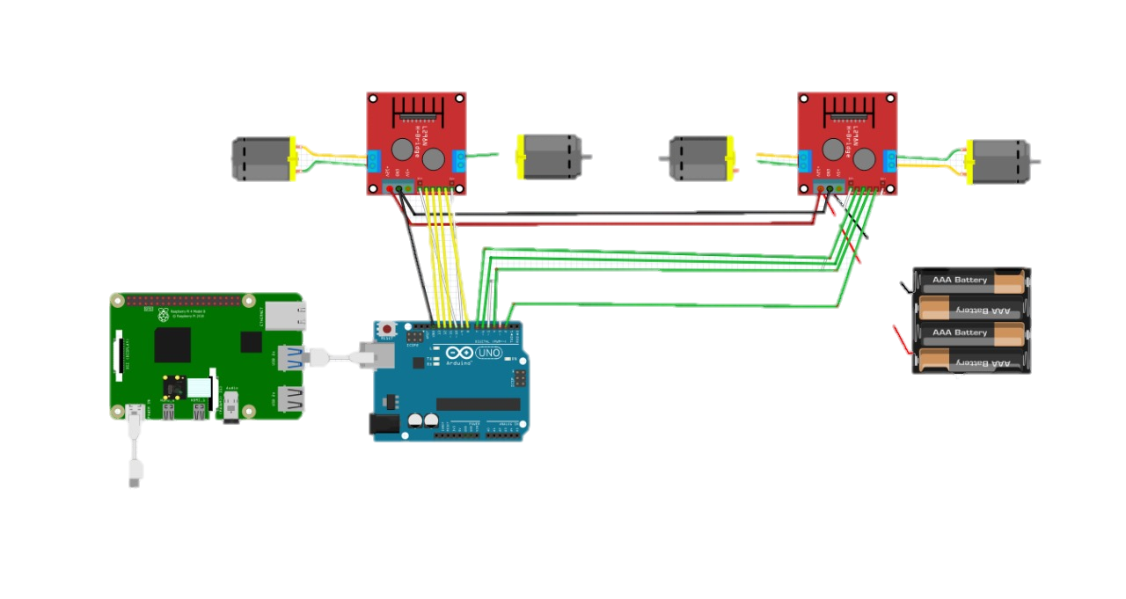
Hardware Implementation
Fully Implemented Hardware & Connections
Introduction
Hardware Implementation
Raspberry Pi &
Camera Setup
Image Processing
Control

Slide 7
Outline
Introduction
Hardware Implementation
Raspberry Pi & Camera Setup (Waleed Atef)
Image Processing
Control

Slide 8
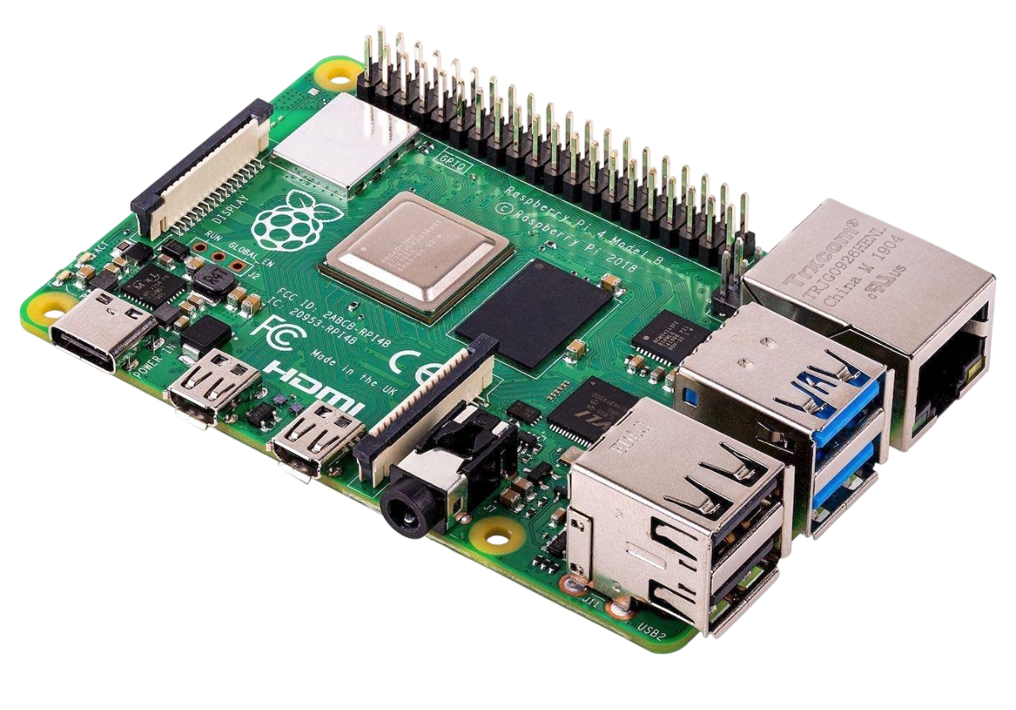
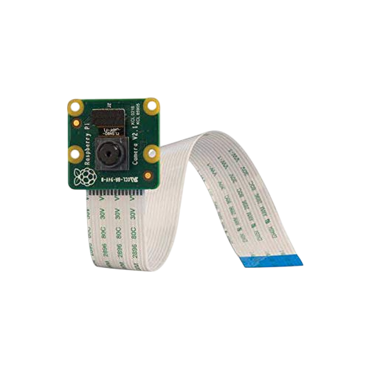
Raspberry Pi & Camera Setup
Raspberry Pi 4 Model B
Raspberry Pi Camera V2
Introduction
Hardware Implementation
Quad-core processor with 4GB RAM which is suitable for running real-time image processing tasks.
Supports Linux-based environments like Raspbian, which makes it easy to run Python, OpenCV, and other image processing libraries.
The official Pi Camera module is well-optimized for the Raspberry Pi, ensuring better compatibility and performance.
Capable of capturing high-resolution images and video (up to 1080p), making it suitable for tasks like detection, classification, or tracking.
Raspberry Pi &
Camera Setup
Image Processing
Control

Slide 9
Outline
Introduction
Hardware Implementation
Raspberry Pi & Camera Setup
Image Processing (Abdullah Mohamed & Omar Magdy)
Control

Slide 10
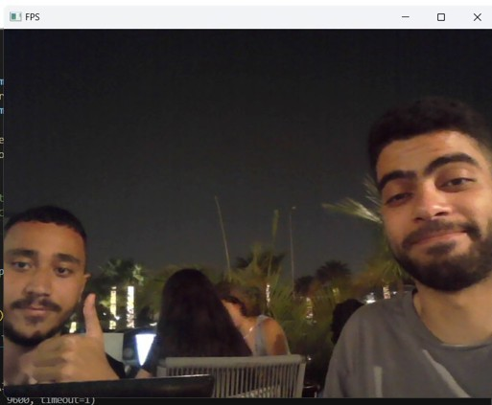
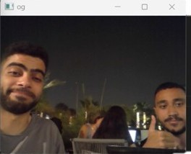
Image Processing
Geometric Transformation
Introduction
Resizing
Flipping
Hardware Implementation
Reduce computational time.
To match the cameras orientation with physical motion.
Raspberry Pi &
Camera Setup
Image Processing
Control

Slide 11
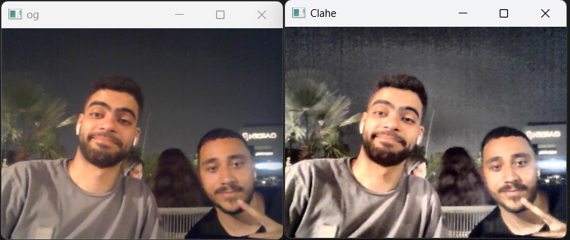
Image Processing
CLAHE (Contrast Limited Adaptive Histogram Equalization)
Introduction
Enhances the contrast and brightness of the image without changing the color.
Hardware Implementation
Raspberry Pi &
Camera Setup
Image Processing
Control

Slide 12
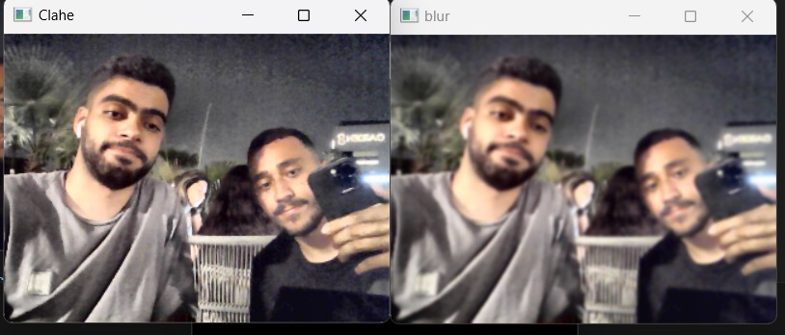
Image Processing
Gaussian Blur
Introduction
Gaussian blur smooths an image by reducing noise and details.
Hardware Implementation
Raspberry Pi &
Camera Setup
Image Processing
Control

Slide 13
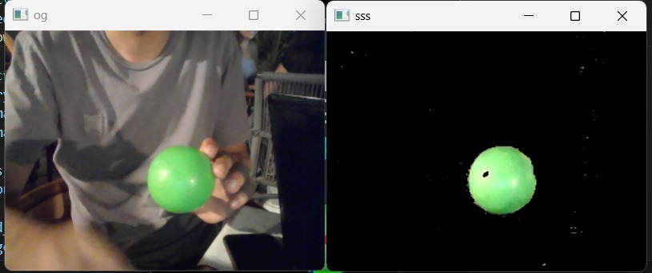
Image Processing
HSV Color Segmentation
Introduction
Segmenting colors and identifying a range of colors that represent the color that needs to be detected
Hardware Implementation
Raspberry Pi &
Camera Setup
Image Processing
Control

Slide 14
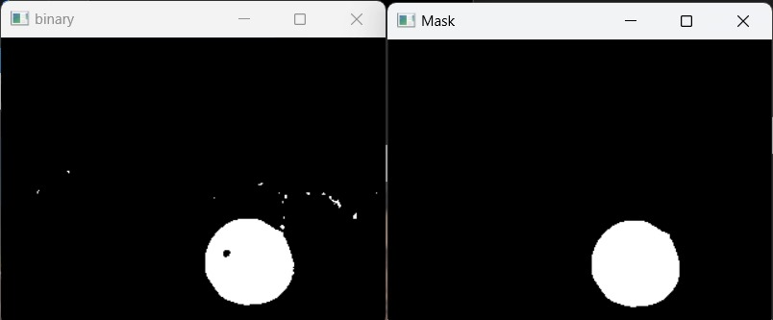
Image Processing
Morphological Operations
Introduction
Morphological opening is used to remove small noises.
Morphological closing is used to close gaps inside detected objects.
Hardware Implementation
Raspberry Pi &
Camera Setup
Image Processing
Control

Slide 15
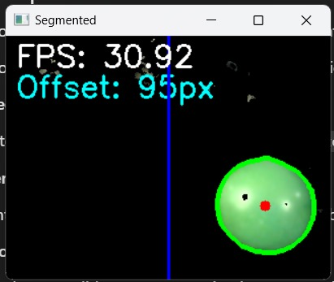
Image Processing
Contour Detection & Centroid Estimation
Introduction
Contours are extracted from the edges of the color detected ball.
The largest contour is assumed to correspond to the ball.
Image moments are used to estimate the centroid of the ball.
Hardware Implementation
Raspberry Pi &
Camera Setup
Image Processing
Control

Slide 16
Outline
Introduction
Hardware Implementation
Raspberry Pi & Camera Setup
Image Processing
Control (Mohamed Shall)

Slide 17
Control
PID Controller
Introduction
Hardware Implementation
Horizontal offset control
Measures how far the object's centroid is from the center of the frame.
Uses a PID controller to compute the required correction.
The intention is to send directional commands (left or right) to adjust alignment.
Distance Control (Area-Based):
Fixed PWM for forward movement
Stopping criteria with a certain contour area.
Raspberry Pi &
Camera Setup
Image Processing
Control

Slide 18


